Slide 1

Student Registration Process in Self Service

Slide 2
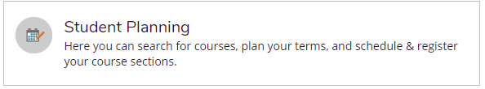
Go to MyMcK;
Click on the Self-Service tile;
Sign In and Click on the Student Planning chicklet

Slide 3
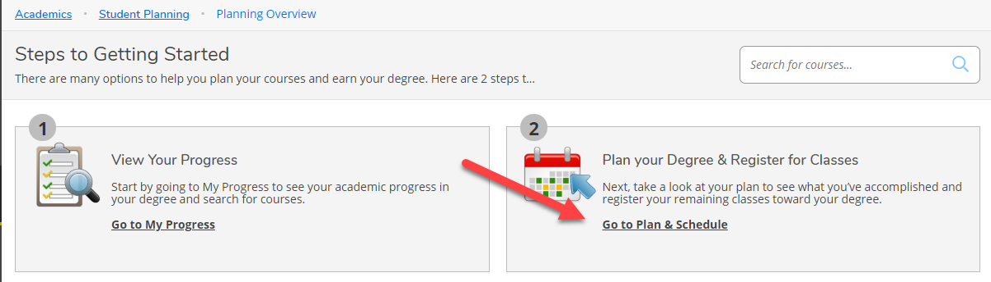
Click on Step 2 – Go to Plan & Schedule

Slide 4
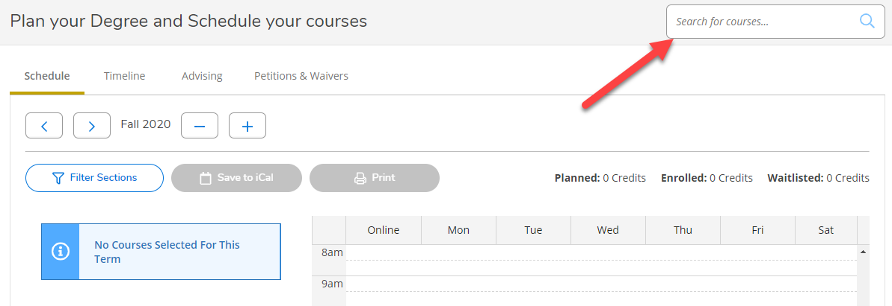
Use the ‘Search for courses…’ text box to search for a specific course. You can type the course name (ENG-111) or course title (Academic Writing). Note: Any course with those words in the title will show in your results – Good way to search for Writing Intensive Courses with WI as your search.
The Filter Sections option on the left hand column can be used to narrow down the results of available courses.

Slide 5
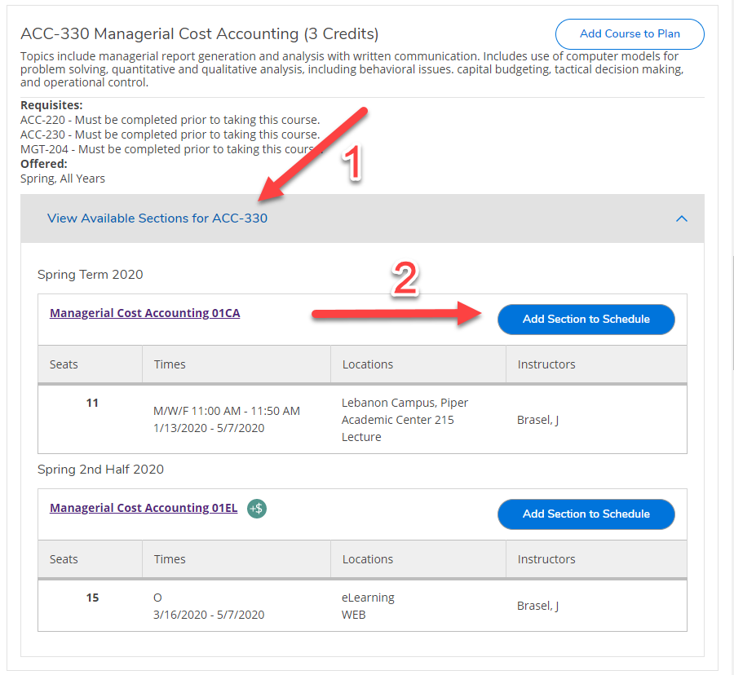
Find the Course Name that is needed and click on ‘View Available Sections for (Course Name)’
Choose ‘Add Section to Schedule’ next to the appropriate section number.

Slide 6
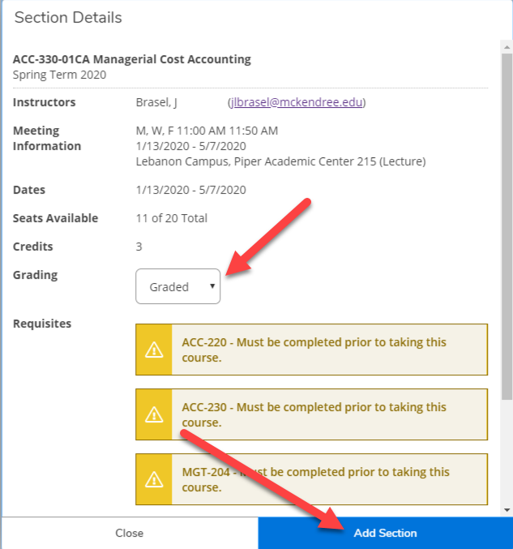
A detailed description of the Section will appear including Instructor, Meeting Information, Dates, Seats Available, Credits, Requisites (with notifications if they have not been completed already), and a Course Description.
Select whether the course will be taken as Graded or Credit/No Credit on this screen and click ‘Add Section’
Any major requirement course has to be taken for a Grade.
Credit hours from a course that is taken for Credit/No Credit does not count towards either Deans or Presidents List. (12 graded hours are required to qualify for either list.)

Slide 7
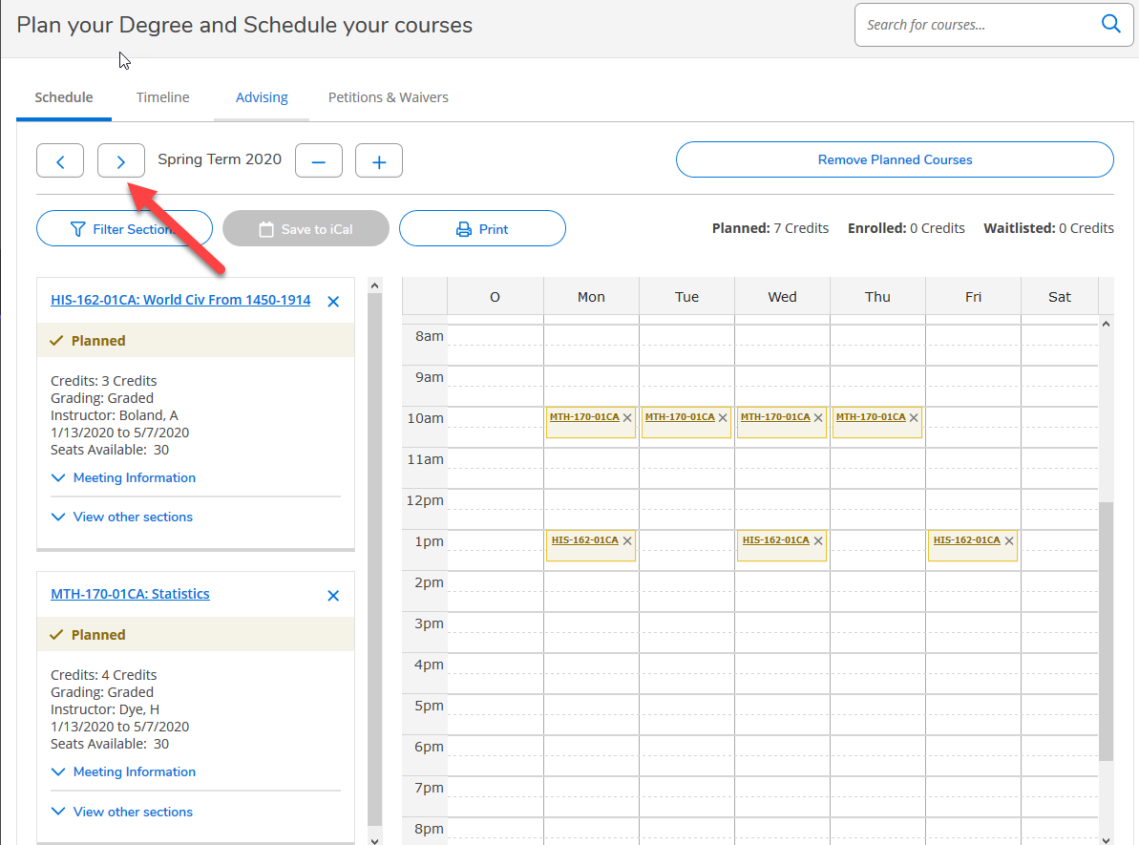
After all sections/courses have been added following the previous steps, click back to Step 2 Plan & Schedule.
View the layout of your proposed schedule that your advisor will review. Each term (Fall, Fall 1, Fall 2) will be listed separately. Click the arrows to scroll all of the relevant terms.

Slide 8
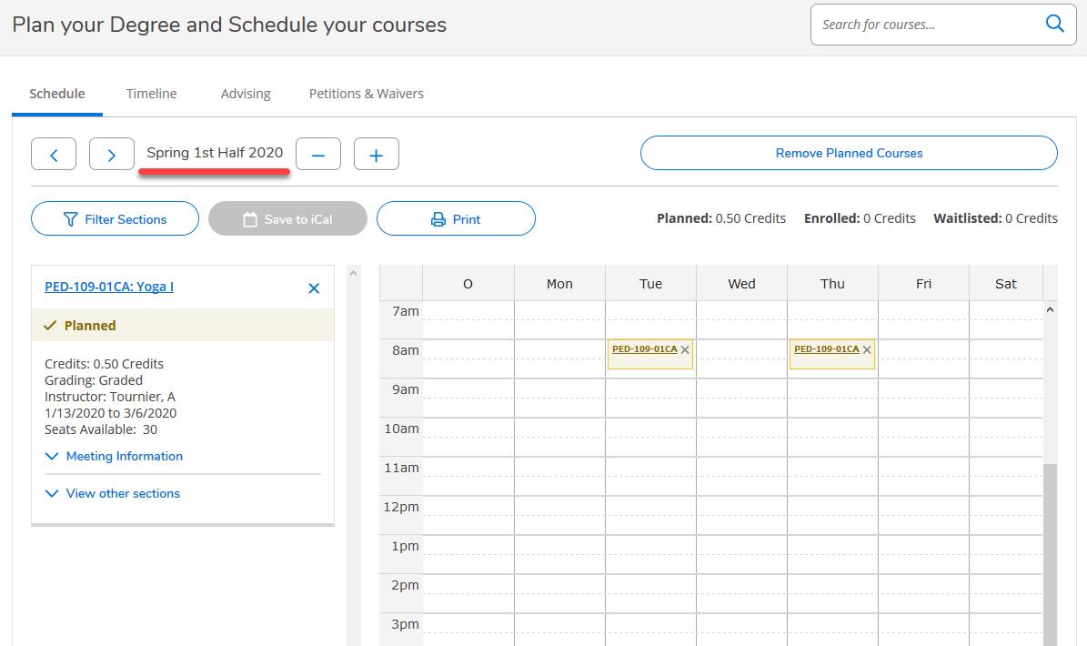
This is the Spring 2 schedule

Slide 9
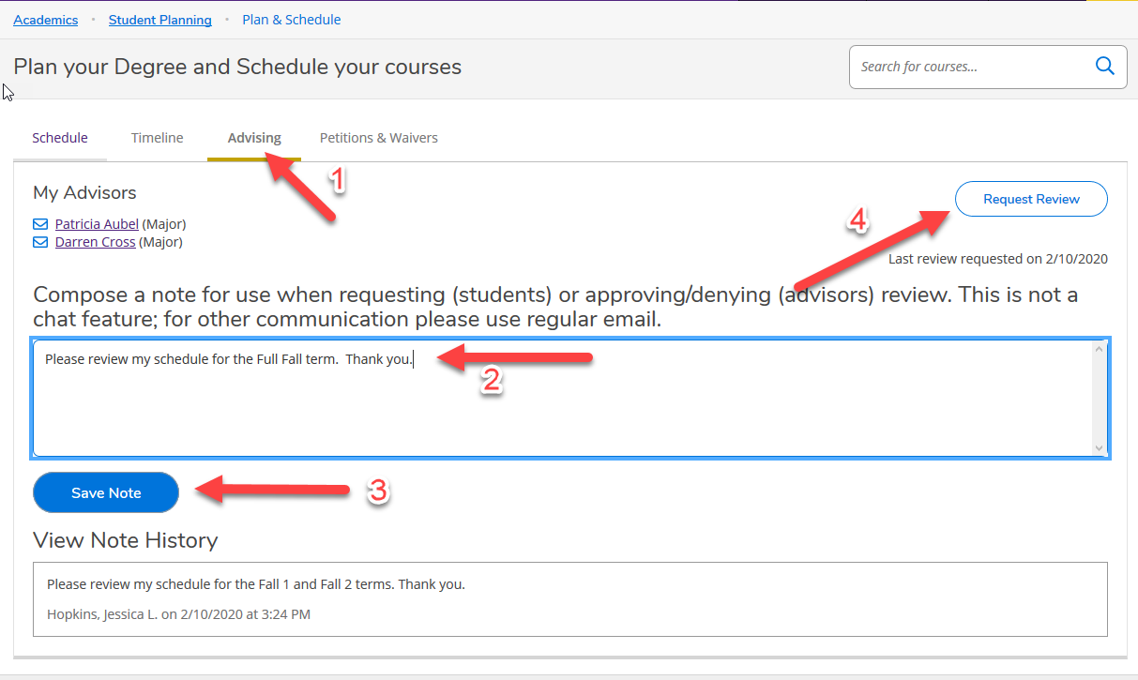
Once your intended schedule is updated how you’d like, click on the Advising Tab and Compose a Note to ask the advisor for review of the terms (Fall, Fall 1, Fall 2) that were updated so they can pay specific attention to those terms.
Click Save Note.
Click Request Review and your advisor will receive an email that you have requested a review.

Slide 10
Notice that all of the Note History going back and forth between the advisor and student will be visible for anybody who has access to the student’s record. This is a great place to reference conversations that have taken place between the student and advisor in the past regarding course and program requirements. Please note: this is not a chat feature. For all other communication, please use regular email.

Slide 11
After Advisement Has Been Completed
- Registration Steps

Slide 12
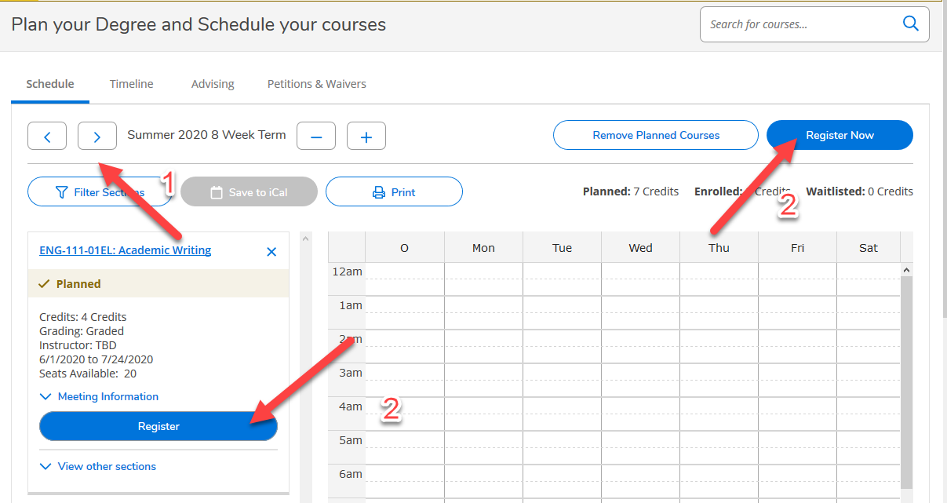
Log into Self-Service
Any notifications to restrict you from registering will be listed and need to be addressed prior to you being able to register.
Click on the Student Planning chicklet
Click on ‘Step 2 - Go to Plan and Schedule’
Click on the Advising Tab to view any notes the advisor has left under the ‘View Note History’ section. The note history stays on the students record and is visible to anybody who has access to the record
Click back to the Schedule tab and select the appropriate term (Fall, Fall 1, Fall 2) that you would like to register courses for by clicking the left and right arrows.

Slide 13
Click on either the ‘Register Now’ button on the top right to register all of the courses for that term, or click the ‘Register’ button next to each course going down the list one by one.
Each term (Fall, Fall 1, Fall 2) will have to be registered for separately. Click on the arrow to browse to the next term and select ‘Register Now’ or ‘Register’ for that term. Repeat the process until all terms have been registered.

Slide 14
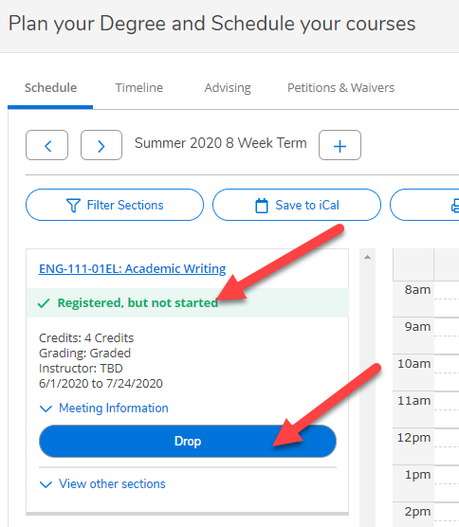
Once each course has been registered the ‘Planned’ label on the left hand column will update to ‘Registered’
The option to Drop a course will be listed on this screen during the approved drop dates.
Before dropping a course, consult with your advisor to verify that the drop will not affect your plan for degree completion, and also with the business office and/or financial aid to verify it will not affect your financial assistance. Student athletes should check with your coach or the Compliance Officer to verify these changes will not affect eligibility.

